Slide 1
Service Integration using Asynchronous Messaging
Praveen Kumar
Computer Science and Engineering
Ohio State University
Notes:
Welcome to the lecture on service integration using messaging. The goal for this lecture is to learn how applications can integrate asynchronously by sending and receiving messages.

Slide 2
Agenda
Asynchronous Http Clients
Introduction to asynchronous integration
Java Messaging Service (JMS)
Summary
Point-to-Point and Publish/Subscribe
Synchronous vs. Asynchronous
Reactive Systems

Slide 3
Part 1 of 4 – Asynchronous Messaging Fundamentals
Notes:
Let’s begin part 1, an understanding of basic concepts around messaging based integration

Slide 4
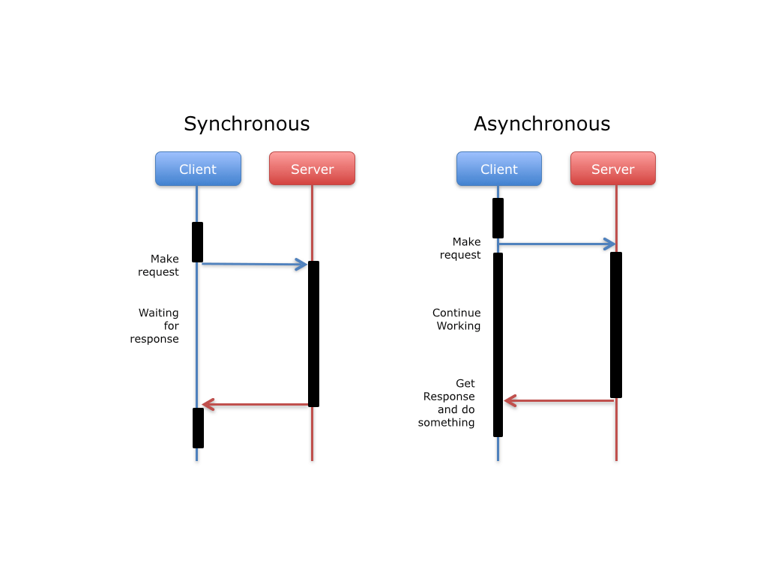
What is Asynchronous?

Slide 5
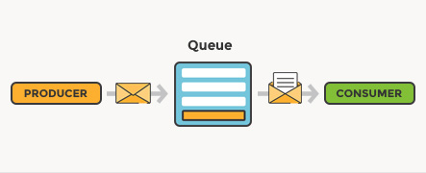
Asynchronous Messaging using an Agent
Asynchronous Production and consumption of a message using a 3rd party agent (Queue)

Slide 6
Synchronous Communication Examples
Chat
Instant Messaging
Video and Audio Conferences
Live Webcasting
Shared Whiteboard

Slide 7
Asynchronous Communication Examples
E-mail
Discussion Forums
Wiki
Blog
Recorded lectures

Slide 8
Synchronous vs. Asynchronous
Synchronous
Asynchronous
The client’s thread blocks (i.e., waits for response) and can’t do anything meaningful. This is a waste of resources
Server must be up and running when client makes the call
Request – Response
Caller’s thread does not block, making best use of underlying resources
Server pulls the message whenever it is free, and does not have to be up and running when client makes the call
Fire-and-Forget

Slide 9
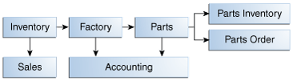
Asynchronous Messaging Based Integration Example
Low inventory message to the Factory
Sales and accounting systems are informed
Parts system attempts to procure all parts
Suppliers are sent a message
Notes:
Here is an example of messaging-based integration used in a manufacturing company, let’s say an automobile company.
The boxes represent applications, while the arrows indicate messages being exchanged.
It begins with an application in the inventory department detecting that the manufactured goods inventory is running low.
It sends a message to the sales department, as well as the factory informing about the situation.
The factory initiates the manufacturing process. It sends a message to parts management, and the accounting for impending purchases it is going to make.
The parts system attempts to procure all required parts.
It sends a messages to parts inventory
It sends a message to parts suppliers, placing orders for additional parts
And, it also sends a message to accounting.
The applications in this enterprise, integrate with other applications using messaging.
Is messaging the right mechanism here? How would you decide? Let’s discuss that next.

Slide 10
When to choose Asynchronous?
Business process is inherently asynchronous – it must inform other processes but continue to operate without waiting for response
An application needs to operate regardless of whether dependencies are up and running
Service provider needs complete decoupling from clients – components might need to be completely replaced and/or relocated
Notes:
When should you choose messaging over other integration mechanism?
Here are a few cases, when messaging will be the right choice.
If the business process is inherently asynchronous, that is, it must inform other processes about something, but continue to operate without waiting for any response
When an application is required to operate whether or not dependencies are up and running. You might have such a scenario when dependent applications are owned and operated by organizations that you have no control over, and
When a service provider needs complete decoupling from clients – the components on the provider application may need to be completely replaced, and/or relocated without affecting any of the clients.
When you notice some or all of the these conditions apply to the problem domain, you should consider message based integration.

Slide 11
Single vs. Multiple Receivers
Sometimes asynchronous messages are meant for a single, known receiver. We use Queues to such communication. This method is called point-to-point integration
When a message producer does not know who or how many receivers are involved, we use Topics to communicate. This method is called publish-and-subscribe integration

Slide 12
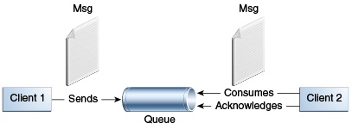
Point-to-Point Integration
Notes:
The point-to-point messaging is based on the concept of message queues. Each message is addressed to a specific, named queue which is meant for one receiver. The receiving client extracts the message and acknowledges it. Queues retain all messages until the messages are consumed or expire.

Slide 13
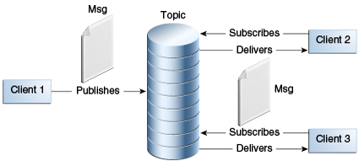
Publish-and-Subscribe Integration
Notes:
In publish/subscribe messaging the producers publish messages to a topic, which functions like a bulletin board. Publishers and subscribers can dynamically publish or subscribe to the topic. The system takes care of distributing the messages arriving from a topic's multiple publishers to its multiple subscribers. Topics retain messages only if it takes to distribute them to subscribers.
The publish/subscribe or pub/sub style has two characteristics:
Each message can have multiple consumers
A client that subscribes to a topic, can consume messages that arrive after it has created a subscription.

Slide 14
Part 2 of 4 – Asynchronous Http Clients
Notes:
Let’s begin to understand techniques used in accomplishing asynchronous integration
One quick way to achieve benefits of asynchronous processing is for clients to invoke Http asynchrony.
Let’s understand that a little bit

Slide 15
Asynchronous Http Clients
Http is a synchronous protocol
Several frameworks provide utility libraries to offload Http call to a background thread, while the main thread is freed up
This makes it look like, especially at the main thread, as if the Http call was asynchronous
JavaScript based frameworks (e.g., Angular) support this technique as default
See: https://angular.io/guide/http#requesting-data-from-a-server

Slide 16
Asynchronous Http Clients – contd.
Several server-side frameworks also support asynchronous integration with REST based microservices
JAX-RS supports this ability
// Explicitly build Asynch client
Client client = ClientBuilder.newClient();
WebTarget target = client.target(url);
Invoker.Builder builder = target.request();
AsyncInvoker asyncInvoker = builder.async();

Slide 17
Asynchronous REST Clients – contd.
Future<MyResponseObject> future = asyncInvoker.get(MyResponseObject.class);
// or
Future<MyResponseObject> future = asyncInvoker.get( new InvocationCallback<MyResponseObject>() {
@Override public void completed(MyResponseObject o) {
// do something with o
}
@Override public void failed(Throwable t) {
// handle the failed request/response
}
});
Source: https://openliberty.io/docs/21.0.0.5/sync-async-rest-clients.html

Slide 18
Benefits and Limitations
The benefit of asynchronous Http Clients is that you can improve user experience (especially in a GUI) with minimal changes on the server or underlying architecture
However, this does not reap the benefits of asynchronous paradigm – in terms of throughput, resource consumption, decoupling etc.

Slide 19
Part 3 of 4 – Reactive Systems

Slide 20
Introduction
Reactive systems is an architecture in which independent systems integrate with each other using asynchronous messaging
Systems built this way are robust, resilient, flexible, and better positioned to meet modern demands
A set of standards and mindset are needed

Slide 21
The Reactive Manifesto
Published in Sept 2014, the reactive manifesto is a mindshare of experts, and it prescribes how to build modern, cloud-scale architectures
It describes 4 key attributes of reactive systems
Responsive
Resilient
Elastic
Message Driven

Slide 22
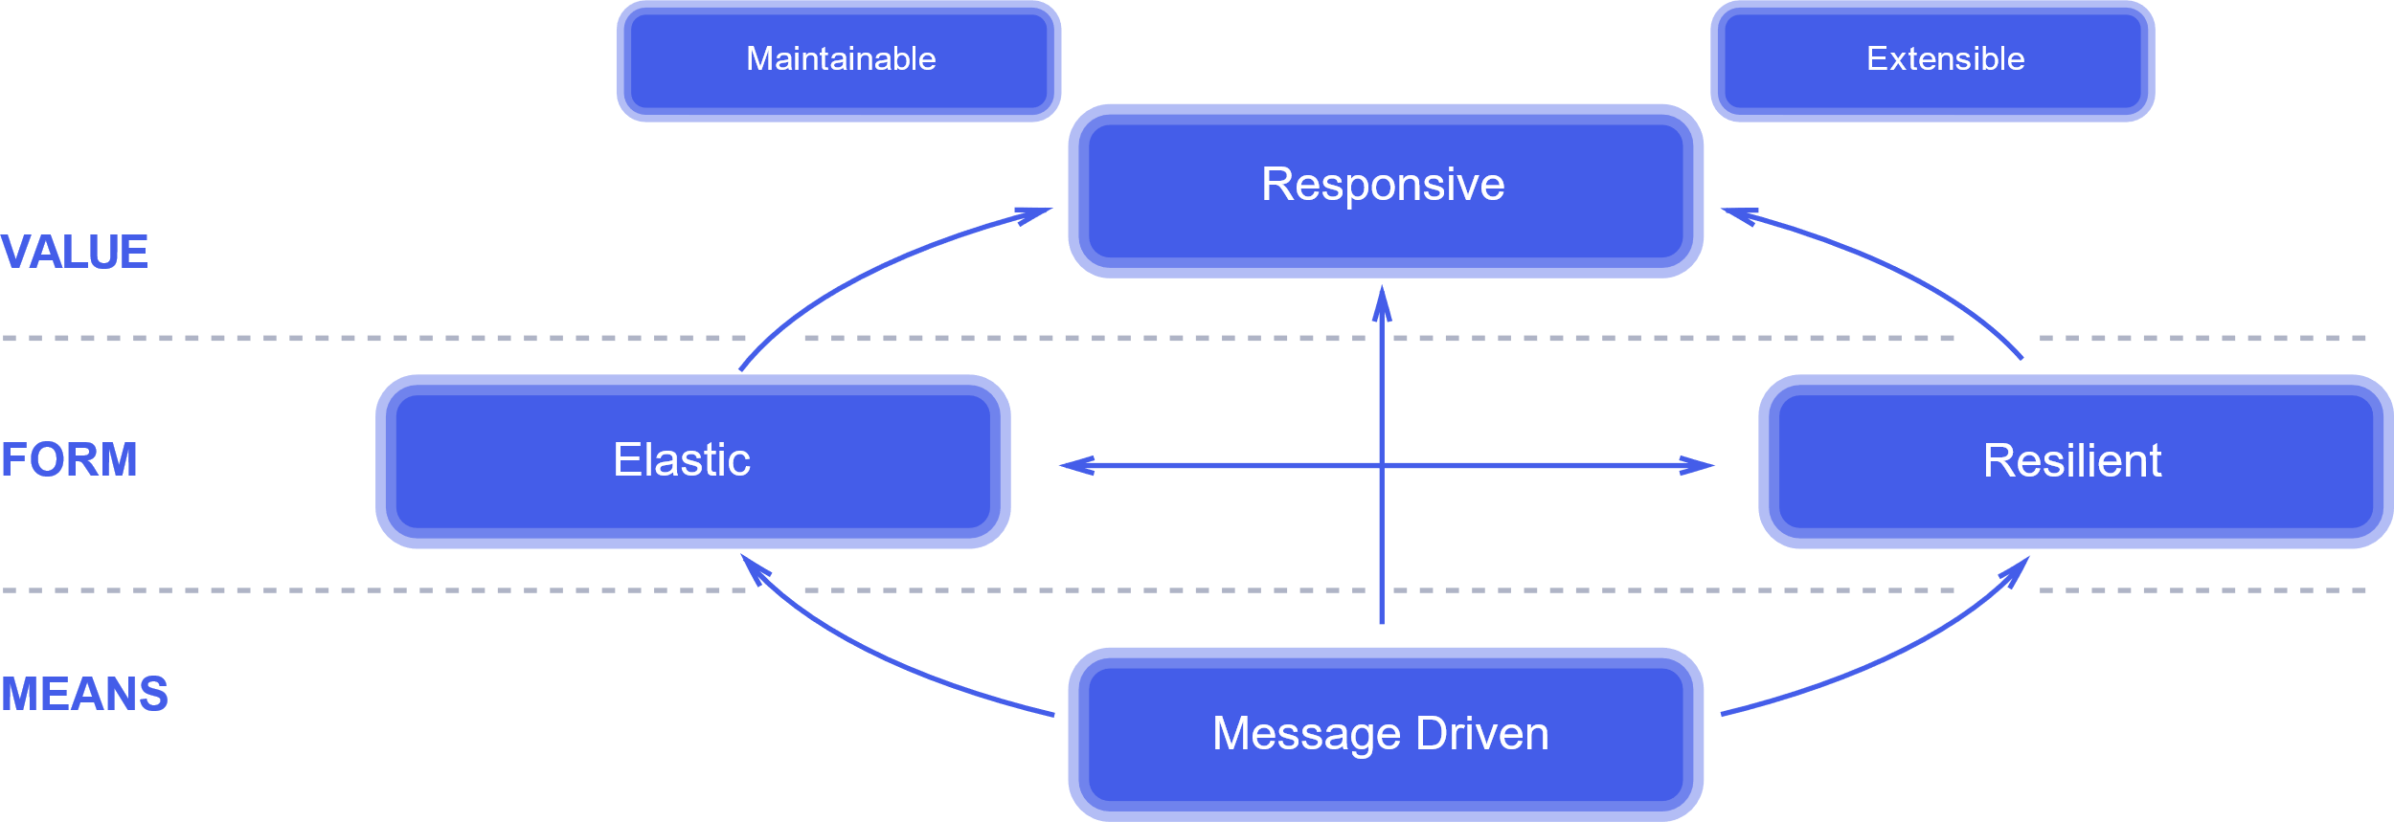
Traits of Reactive Systems
Traits of Reactive Systems,
Source: https://www.reactivemanifesto.org/

Slide 23
Reactive Systems – contd.
Term | Meaning
Responsive | System will provide rapid and consistent response time. Consistency simplifies error handling.
Resilient | System stays responsive in the face of failure. This is achieved by replication, containment, isolation, and delegation.
Elastic | System stays responsive under varying workload. System can detect change in input rate and adjust allocation of resources.
Message Driven | System relies on asynchronous message-passing to establish a boundary, which ensures loose coupling, and location transparency. Uses back-pressure when necessary.

Slide 24
How to build reactive systems?
The required ingredients are:
Distributed event streaming platform (agents)
Standard APIs to publish and consume events
Network protocol
Reactive Streams provide a standard specification
The architecture is also known as reactive programming

Slide 25
What is Reactive Streams?
Reactive Streams is an initiative to provide a standard for asynchronous stream processing with non-blocking back pressure
The goals:
A set of standard APIs, protocols, and runtime environments (JVM and JavaScript)
Foundation for reactive systems architecture
Interoperability
See: https://www.reactive-streams.org/

Slide 26
Reactive Streams API in Java
A publisher is a provider of a potentially unbounded number of sequence elements, publishing them according to the demand received from its subscribers
public interface Publisher<T> {
public void subscribe(Subscriber<? super T> s);
}

Slide 27
Reactive Steams API (contd.)
Subscriber
public interface Subscriber<T> {
public void onSubscribe(Subscription s);
public void onNext(T t);
public void onError(Throwable t);
public void onComplete();
}

Slide 28
Reactive Steams API (contd.)
Subscription
Processor
public interface Subscription {
public void request(long n);
public void cancel();
}
public interface Processor<T, R> extends Subscriber<T>, Publisher<R> {
}

Slide 29
Notable Reactive Steams Implementations
RxJava (out of ReactiveX project).
This project has implementations for multiple languages including Java, JavaScript, .NET (C#), Scala, Clojure, C++, Ruby, Python, PHP etc.
Reactor (Spring project)
Akka Streams
Ratpack
Vert.x

Slide 30
Reactive Microservices
A microservices based architecture that uses the reactive streams as integration backbone
Provides design principles and best practices

Slide 31

Apache Kafka
An open-source distributed computing streaming platform
Popular in large enterprises for mission-critical reactive systems
https://kafka.apache.org/

Slide 32
Part 4 of 4 – Java Messaging Service (JMS)

Slide 33
Java Messaging Service (JMS)
JEE component which allows JEE applications to create, send, receive, and read messages
Complete messaging capability
Provides standard API and semantics
JMS operations can participate in JTA transactions (e.g., DB write & messaging)
Abstracts complexity
Notes:
Java Messaging Service or JMS is a JEE component which allows JEE based applications to create, send, receive, and read messages
It offers a complete set of messaging capability, including point-to-point and pub/sub styles
It provides standard API and semantics, which allows JMS based applications to be portable across JMS providers
JMS operations can participate in JTA transactions, such as a database write & a message send or receive operation
It abstracts complexity. The JMS API minimizes the set of concepts a programmer must learn in order to use messaging products but provides enough features to support sophisticated messaging applications
Let’s learn about JMS API architecture next.

Slide 34
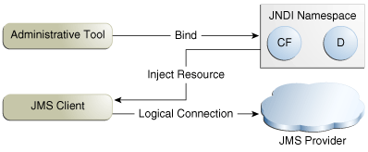
JMS API Architecture
JMS Client – applications that send & receive messages
JMS Provider – messaging system and associated administrative tools (part of JEE application server)
Message – objects that communicate information
Administered objects – queues, topics, connection factory etc. Created (configured) using admin tools, accessible via JNDI
Notes:
Shown here are basic JMS API concepts which you must know before getting started to write JMS based applications.
JMS Client – are applications that send & receive messages
JMS Provider – is the messaging system and associated administrative tools. It is part of JEE application server.
Message – are objects that communicate information between JMS clients, and
Administered objects – are objects such as queues, topics, connection factory etc., that are configured for use by the clients. Typically an administrator uses admin tools, to configure these objects, and assigns them a JNDI name, making them available to JEE applications.
Now that you have basic concepts of JMS API, let’s understand the programming model.

Slide 35
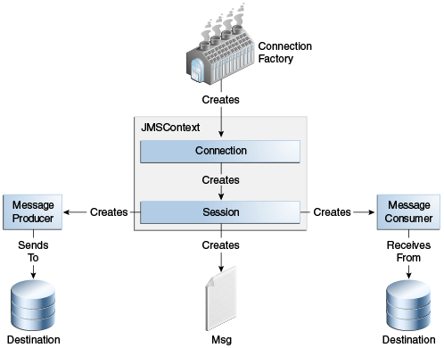
Using JMS API
Notes:
Here are basic building blocks of JMS applications.
Connection Factory – this is used for creating JMS Context objects such as connection and sessions, used for creating and receiving messages.
Destinations – these are queues and topics, that JMS clients send messages to, and receive message from.
Message Providers and Message consumers are helpers that JMS clients use to accessing messages.
Let’s take a look at how this all works together.

Slide 36
Using JMS API (contd.)
Create administered objects using application server specific toolkit, assign JNDI names
Inject administrative objects into JMS clients
@Resource(lookup = "java:comp/DefaultJMSConnectionFactory")
private static ConnectionFactory connectionFactory;
@Resource(lookup = "jms/MyQueue")
private static Queue queue;
@Resource(lookup = "jms/MyTopic")
private static Topic topic;
Notes:
The first step in using JMS is to create administered objects using application server specific toolkit. Most commercial JEE container providers contain GUI based tools, that you can use to create connection factory, and destinations such as queues and topics .
The second step is to inject the administered objects into JMS clients, using @Resource annotations and JNDI name. Code snippets here show how exactly you can do that.

Slide 37
Using JMS API (contd.)
Create JMSContext instance
Create providers & consumers to send/receive messages
try (JMSContext context =
connectionFactory.createContext();) {
context.createProducer().send(queue, msg);
...
Message m =
context.createCosumer(queue).receive(1000);
...
}
Notes:
The third step is to create JMSContext instance using the connection factory.
The code shown here uses try-with-resources block. If you do that, then you do not need to explicitly close the connections within JMS context.
The fourth step is to create producers to send messages to a destination, and to create a consumer on a destination and receive messages.
Notice, that the consumer here will block while receiving a message. If the queue has no message, the consumer will wait for 1000 milliseconds (i.e. 1 second) for message to arrive, and after that it will timeout.

Slide 38
JMS Message Listener
Used when you want JMS to notify you when a message arrives
Create a listener, and register with consumer
public class MyListener implements MessageListerner {
public void onMessage(Message msg) { ... }
}
context.createConsumer(queue).setMessageListener(
new MyListener());
Notes:
JMS listeners are used when you want the JMS to notify you when a message arrives.
In order to accomplish that, you first need to define a class which implements MessageListener interface, and has one public method called onMessage(). This method will be called by JMS when a message arrives on the specified queue. This step is shown in the first code block
Then, within message consumer code, register the message listener with the consumer, as shown in the second block of code here.
This technique is also known as “asynchronous consumption of messages”. Does it sound similar to Hollywood pattern?

Slide 39
JMS – Consuming from topic
To consumer from topics, you need to create a subscription, which you can close later.
JMSConsumer consumer =
context.createDurableConsumer(myTopic, “MySub”);
// consumer messages ...
// done with listening to messages
consumer.close();
context.unsubscribe(“MySub”);
Notes:
To consumer from topics, there is an additional step. You need to create a subscription on the topic, before you can consume any message. You can accomplish that by creating a durable consumer as shown in the code block here.
When you are done, you should close the consumer as well as unsubscribe from the topic. The code snippets are shown here.
Subscriptions can be durable or non-durable. They can also be shared by consumers. A more detailed discussion on this topic is beyond the scope of this course. Java EE 7 tutorial, and Oracle documentation on JMS 2.0 Shared subscriptions are excellent places to learn more. See the references section for links.

Slide 40
JMS Messages
Simple but highly flexible format
Can match formats used by non-JMS applications in heterogeneous platforms
Defined in abstract way, concrete classes are JMS vendor specific.
Three parts: header, properties, and body. Only header is required.
Can carry six types of messages in the body, mapped to certain Java types
Notes:
The ultimate purpose of a JMS application is to produce and consume messages that can then be used by other software applications.
JMS messages have a basic format that is simple but highly flexible,
It allows you to allowing you to create messages that match formats used by non-JMS applications on heterogeneous platforms.
JMS messages are defined in abstract way, that is, the API defines certain interfaces and abstract classes. The concrete classes are JMS vendor specific.
A JMS message can have three parts: a header, properties, and a body. Only the header is required.
JMS API defines six different types of messages. Each message type corresponds to a different message body, and map to certain Java types. These messages allow you to send and receive data in many different forms.
Let’s now understand message parts a bit more next.

Slide 41
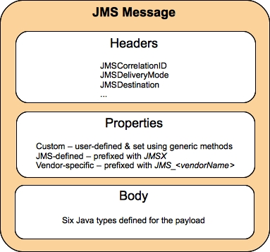
JMS Message Structure
Predefined header fields, with getters/setters
Message Types:
TextMessage
MapMessage
BytesMessage
StreamMessage
ObjectMessage
Message
Notes:
Shown here are three parts of a JMS message.
The header contains a number of predefined fields that contain values used by both clients and providers to identify and route messages. Each field has associated getter and setter methods defined in the Message interface. Some header fields are intended to be set by a client, but many are set automatically by the send method, which overrides any client set values. Some of these fields are;
JMSMessageID, JMSCorrelationID, JMSDeliveryMode, JMSDestination, JMSType etc.
You can create and set properties for messages if you need values in addition to those provided by the header fields. You can use properties to provide compatibility with other messaging systems. The JMS API provides some predefined property names that begin with JMSX.
The JMS API defines six different types of messages. Each message type corresponds to a different message body. These message types allow you to send and receive data in many different forms. These message types are defined here.
TextMessage contains Java String in the body.
MapMessage contains a set of name value pairs
BytesMessage contains a stream of un-interpreted types
StreamMessage contains a stream of primitive values in Java programming language, filled and read sequentially
ObjectMessage contains a serializable object in the Java programming language
Message contains nothing. Composed of header fields and properties only. This type is useful when the message body is not required.

Slide 42
JMS Messages – Example
Creating and consuming text messages
TextMessage message = context.createTextMessage();
message.setText(msg_text); // msg_text is String
context.createProducer().send(message);
Message m = consumer.receive();
if (m instanceof TextMessage) {
String message = m.getBody(String.class);
System.out.println(message);
} else {
// Handle error or process another message type
}
Notes:
Here is an example of creating and consuming text messages.
The key method names are highlighted. As you can see, the JMSContext supports creation of actual message instances, and you can set body fields, custom attributes, and body content by calling appropriate methods, as defined in JMS API.
Similarly, after you receive a message, you can use methods defined in JMS API to extract message body and process it in your business logic.
Hopefully, this simple example gives you a good idea about how to create and consume messages.

Slide 43
Message Driven Beans (MDB)
Special kind of EJB component, designed to receive JMS messages asynchronously
Uses @MessageDriven annotation
Implements MessageListener interface, and has just one method: onMessage()
EJB container takes care of subscription
EJB container creates a pool of MDB instances, and allows very fast processing
Scales well for highly variable demands
Notes:
Message Driven Beans or MDB are Special kind of EJB component, designed to receive JMS messages asynchronously.
There are no remote or local interfaces. Just one bean class which uses @MessageDriven annotation
An MDB class, implements MessageListener interface, and has just one method: onMessage().
EJB container takes care of creating subscription etc., which you had to code yourself in the JMS client, as you saw in JMS examples earlier
EJB container creates a pool of MDB instances, and allows very fast processing when a large pool of messages from various clients are expected.
MDBs scale very well for highly variable demands
In essence, MDBs are message listeners, and you can configure and manage them in EJB container.
If you are message consumer, and you need to implement business logic in response to messages, the Message Driven Beans are an excellent choice.

Slide 44
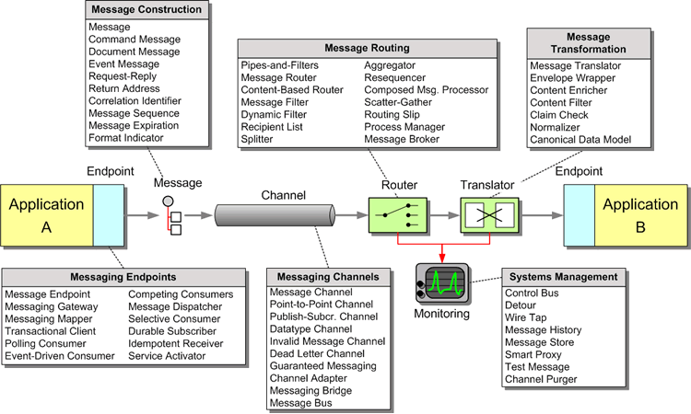
Message Integration Patterns
Image Credits: http://www.enterpriseintegrationpatterns.com/patterns/messaging/
Notes:
Application integration using messaging is a key technique used by enterprises, and there are several best practices and patterns available.
The attached diagram is from a famous book by Gregor Hohpe and Bobby Woolf, Enterprise Integration Patterns. It provides an overview of available design patterns that address various concerns.
The diagram is very busy, but I want you to pay close attention to key aspects in a messaging based system, that you need to address. They are: messaging endpoints, message construction, channel, routing, translation, and system management.
When you have a need to build a high performance and scalable messaging based system for an enterprise, you should consider these patterns.
Image Credits: http://www.enterpriseintegrationpatterns.com/patterns/messaging/

Slide 45
What have we learned?
1
2
Synchronous vs. Asynchronous
3
Point-to-Point vs. Publish/Subscribe
What is asynchronous integration
4
Asynchronous Http Clients
Reactive Systems
5
Java Messaging Service (JMS)
6

Slide 46
References
Messaging. (Java EE) 7: The Java EE Tutorial. Retrieved Sept. 2015, from https://docs.oracle.com/javaee/7/tutorial/partmessaging.htm#GFIRP3
Enterprise Messaging System. In Wikipedia, the free encyclopedia. Retrieved September 2015 from https://en.wikipedia.org/wiki/Remote_procedure_call
Messaging Patterns Overview. In Enterprise Integration Patterns. Retrieved September 2015, from http://www.enterpriseintegrationpatterns.com/patterns/messaging/
Hachitani et. al. (July 2015). IBM WebSphere Application Server Liberty Profile Guide for Developers. IBM Redbooks. Retrieved September 2015, from http://www.redbooks.ibm.com/redbooks/pdfs/sg248076.pdf
Notes:
Here are a few references, which will help you get a deeper understanding of topics.

